Slide 1



The Convergence of the telematic, computing and information services as a basis for using artificial intelligence to manage complex techno-organizational systems

Slide 2

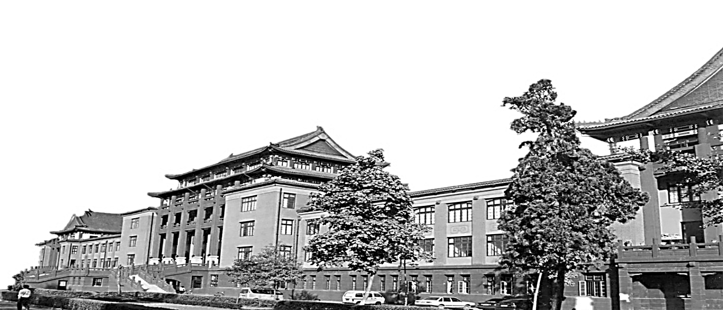
$. Table Of Contents
Table Of Contents
01
Introduction
02
Problem statement
03
Solution
04
Conclusion
05
Summary

Slide 3

I. Introduction
use the artificial intelligence to manage complex techno-organizational systems

Slide 4
II. Problem statement
increased risks
characteristics
Characteristics
chronotype, participants, role structure, etc

Slide 5
III. Solution
converged information
computing platform
self-organizing integration
intellectual analysis

Slide 6
IV. Conclusion
Five elements
Five modules

Slide 7
V. Summary
Using artificial intelligence helps manage complex techno-organizational system in the aerospace industry. It has more opportunities to collect, process, keep and distribute information. However, there is a possibility that it maybe increase risk of distinguishing the organizational strategy of controlled space objects. To ensure the safety and effective use of complex techno-organizational systems in the aerospace industry in the process of self-organizing integration, a method of intellectual analysis of the fractal organization of key element relationships is proposed, using a multidimensional interpretation of the linkage systematics and operational-regime control transactions.

Slide 8
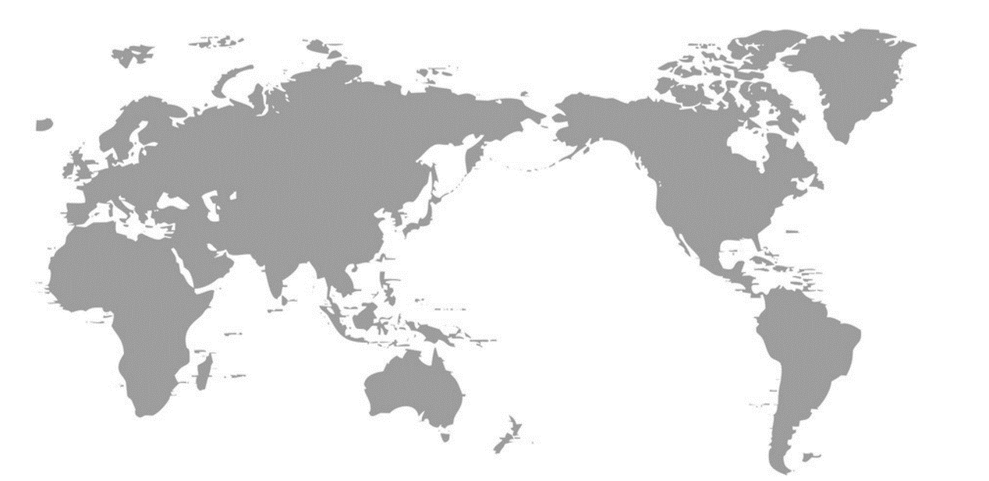


T | H | A | N | K |  | Y | O | U
Designed By Yang Dexing, Sichuan University,@四川大学杨德兴 欢迎使用

